Slide 1

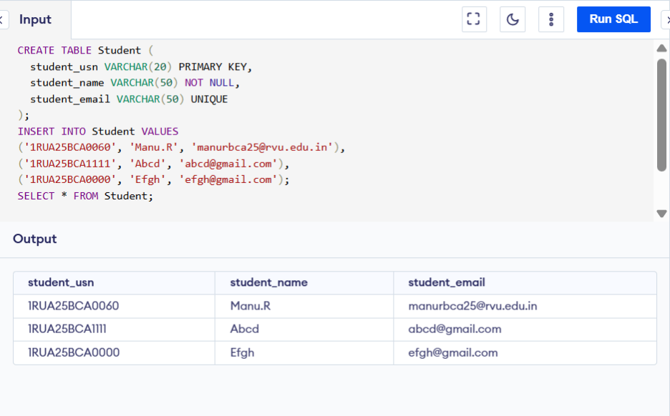
DDL Commands in SQL
Creating a Table
Altering the table for adding the columns

Slide 2
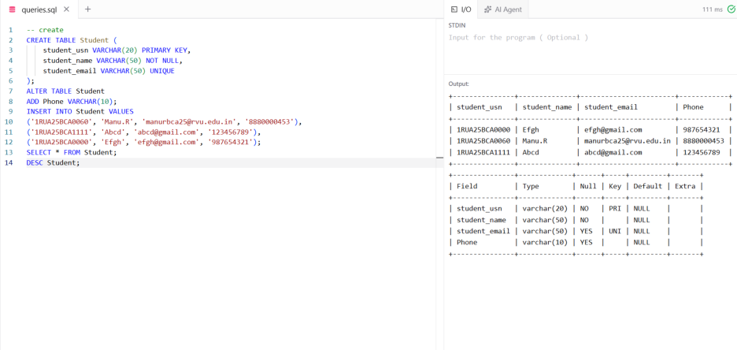
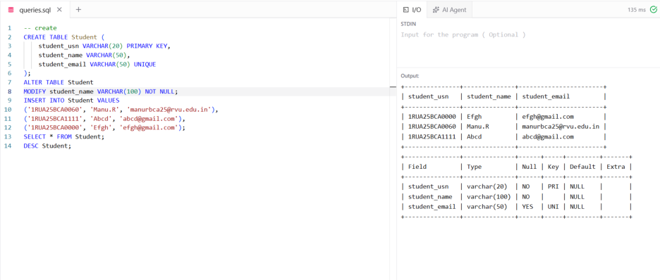
Modifying the Columns using Alter
Dropping the Column using Alter

Slide 3
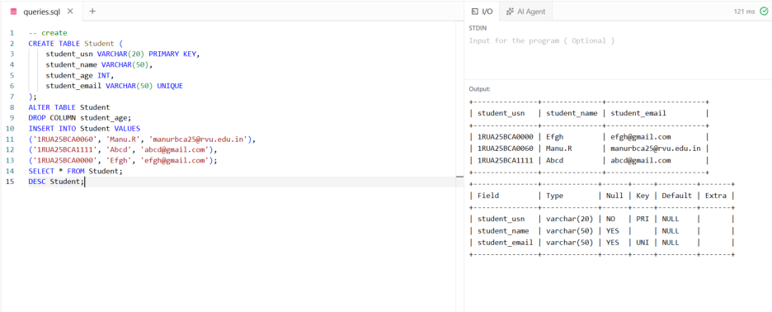
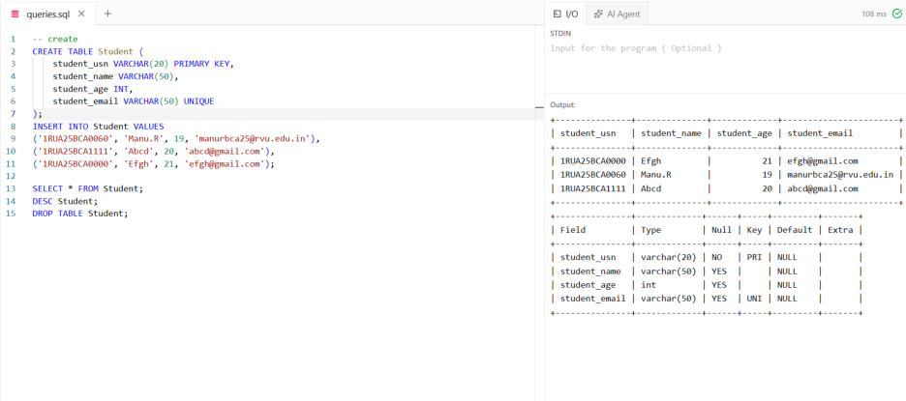
Dropping the Table

